Slide 1
Monotasks: Architecting for Performance Clarity in Data Analytics Frameworks
Kay Ousterhout Christopher Canel Sylvia Ratnasamy Scott Shenker
UC Berkeley Carnegie Mellon University UC Berkeley UC Berkeley, ICSI
姚倚森 118037910065

Slide 2


Background
My server cluster
Why it is slow?
No model
Double my server
How will my performance be improve?
No model

Slide 3
Example: Words Count
Bottleneck on network
Bottleneck on CPU
Bottleneck on disk
How Spark does:
Task 1: Read block 1, count and write result to disk
Network
Compute
Disk
Challenge 2: different task contend same resources
Challenge 1: different bottleneck on different times

Slide 4
Design of Monotasks
Each monotask uses one resource.
Today’s pipeline
Network
Compute
Disk
Each Monotask uses a single resource
Network monotask
Compute monotask
Disk monotask
Monotasks don’t start until all dependencies complete

Slide 5
Design of Monotasks
Each monotask uses one resource.
____________
Dedicated schedulers control contention
Network scheduler
CPU scheduler 1
CPU scheduler 2
CPU scheduler 3
Disk scheduler 1
Disk scheduler 2

Slide 6
Design of Monotasks
Each monotask uses one resource.
____________
Dedicated schedulers control contention
____________
Per-scheduler have complete control
Network scheduler
CPU scheduler 1
CPU scheduler 2
CPU scheduler 3
Disk scheduler 1
Disk scheduler 2
No OS write buffer, all flush to disk

Slide 7
Design of Monotasks
Each monotask uses one resource.
____________
Dedicated schedulers control contention
____________
Per-scheduler have complete control
Network scheduler
CPU scheduler 1
CPU scheduler 2
CPU scheduler 3
Disk scheduler 1
Disk scheduler 2
No OS write buffer, all flush to disk

Slide 8
Monotasks performance model
Bottleneck at disk
Idel network runtime
Idel CPU runtime:
CPU monotasks/CPU cores
Idel disk runtime

Slide 9
If I doubled my disk…
New runtime
Bottleneck at network
Idel network runtime
Idel CPU runtime:
CPU monotasks/CPU cores
Idel disk runtime

Slide 10
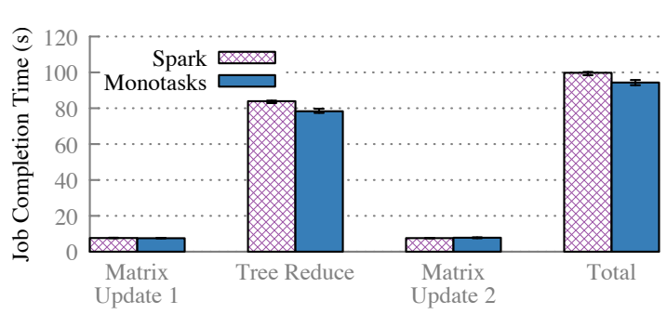
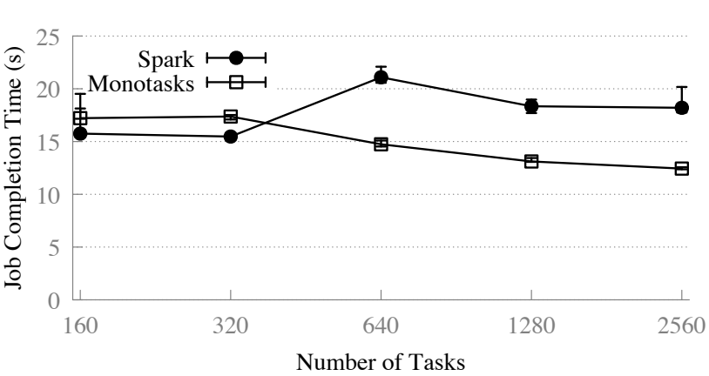
Evaluation
Does Monotasks make the system slower?
No more than 9%
Comparison of Spark and Monotask,
a machine learning workload,
15 machines.
Comparison of Spark and Monotask,
a job that reads input data and then computes,
20 workers (160 cores).

Slide 11
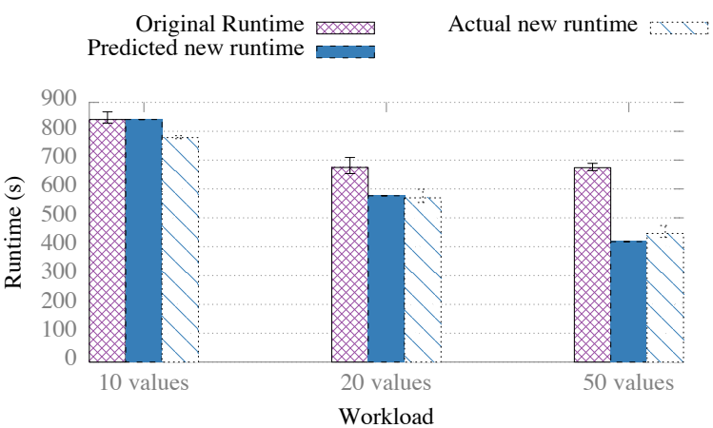
Evaluation
Predictions for performance
a cluster of 20 8-core, 1 SSD machines
Double disks on each machines, error in 10%

Slide 12
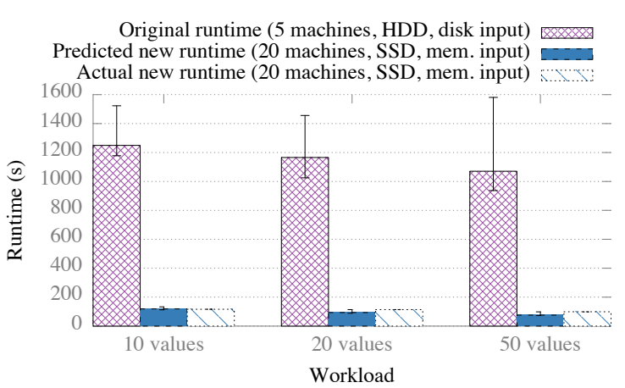
Evaluation
Predictions for performance
a workload
from 5 machines with HDD and input stored on-disk
to 20 machines with SSD and input stored in-memory,
with an error of at most 23%.

Slide 13
Conclusion
A new architecture for distributed computing system
Pros:
Great Performance clarity
Little hurt to performance
Cons:
Not suit for few tasks/ large tasks
Simple scheduler

Slide 14

Q&A

